Slide 1


Slide 2
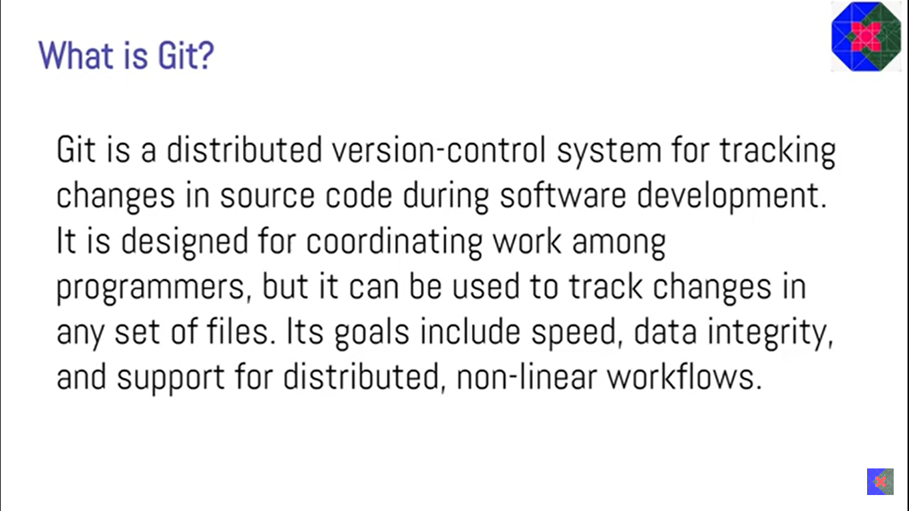

Slide 3
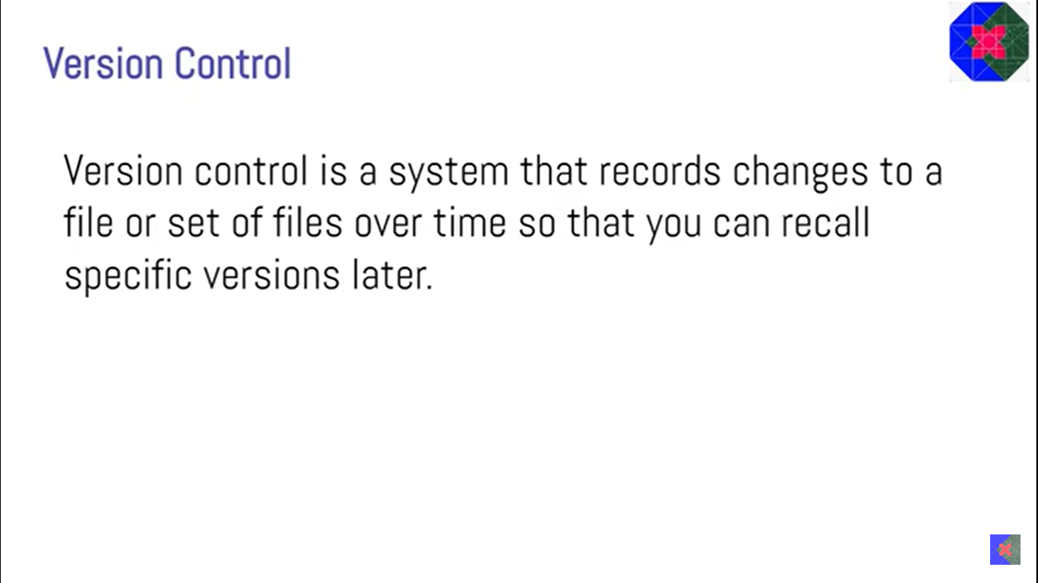

Slide 4


Slide 5
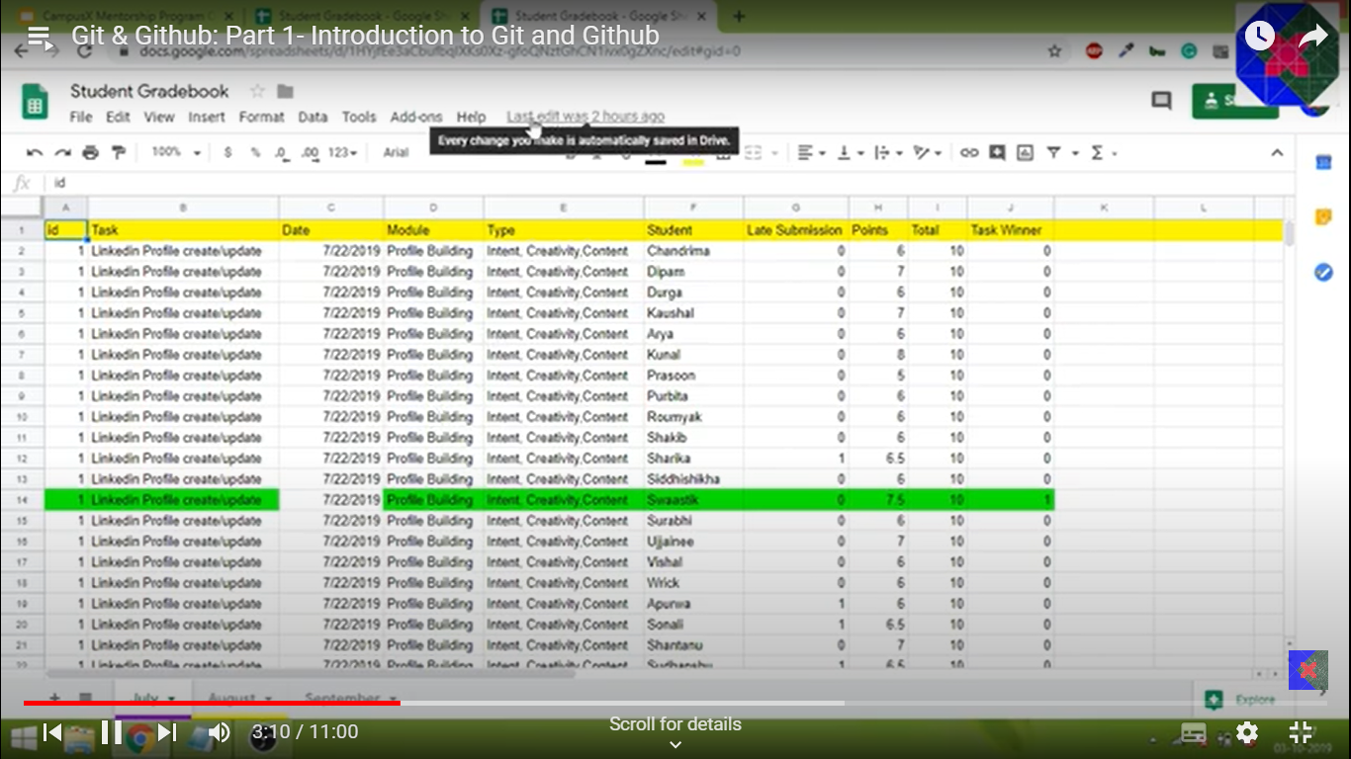

Slide 6
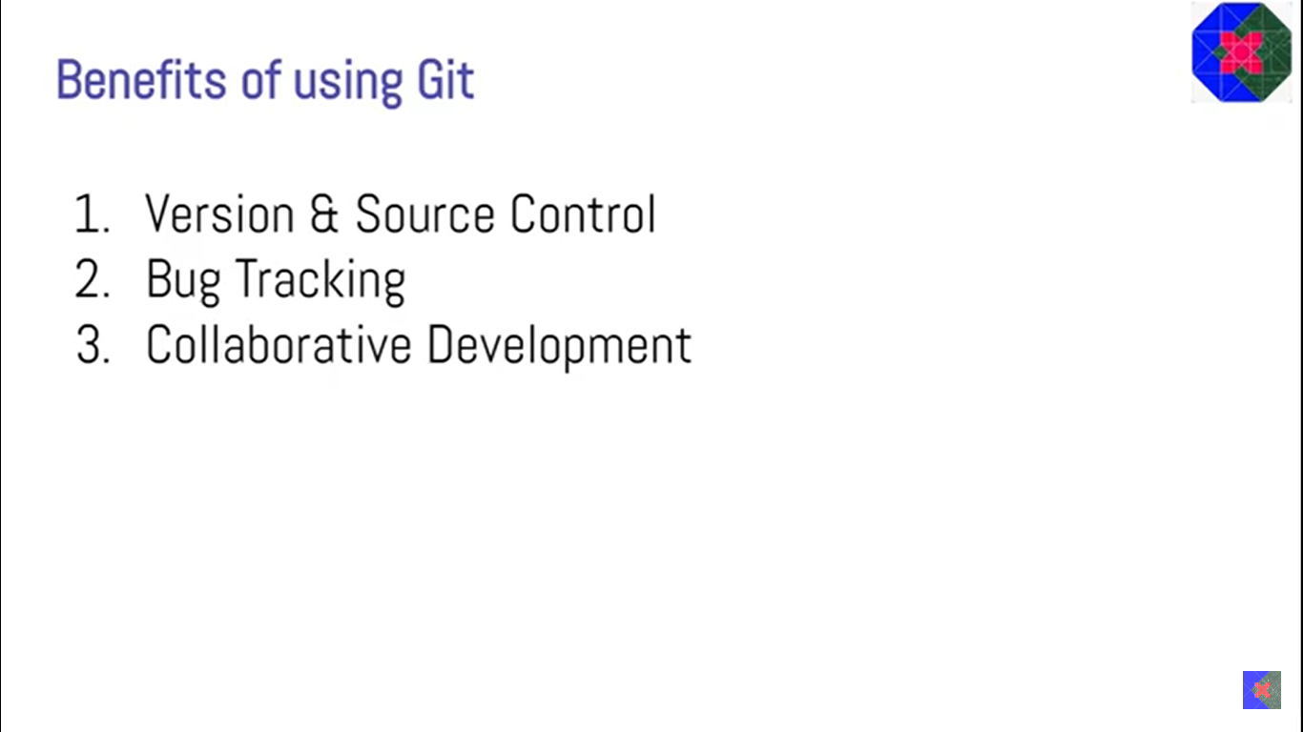

Slide 7


Slide 8
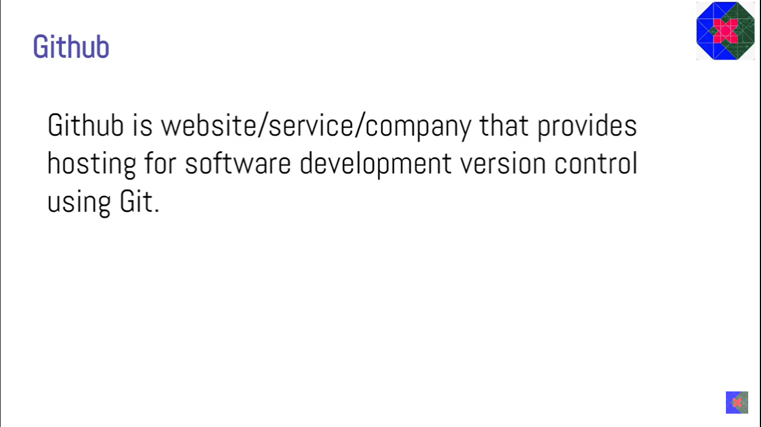

Slide 9
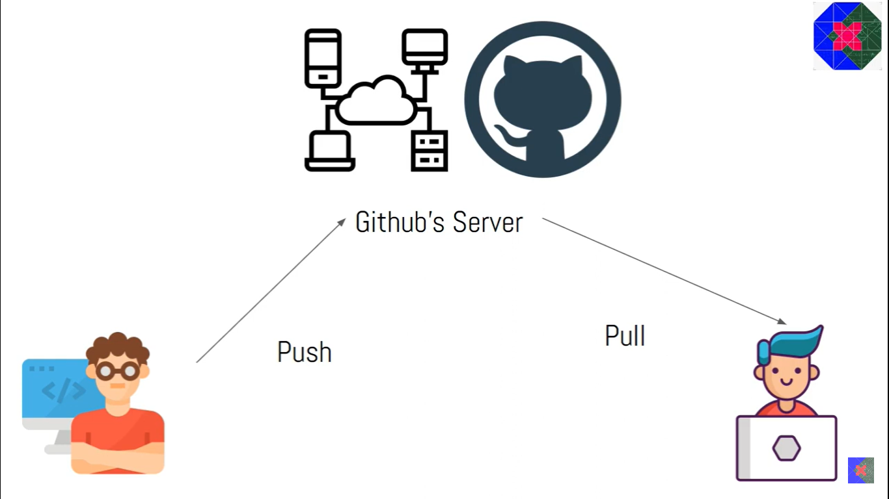

Slide 10
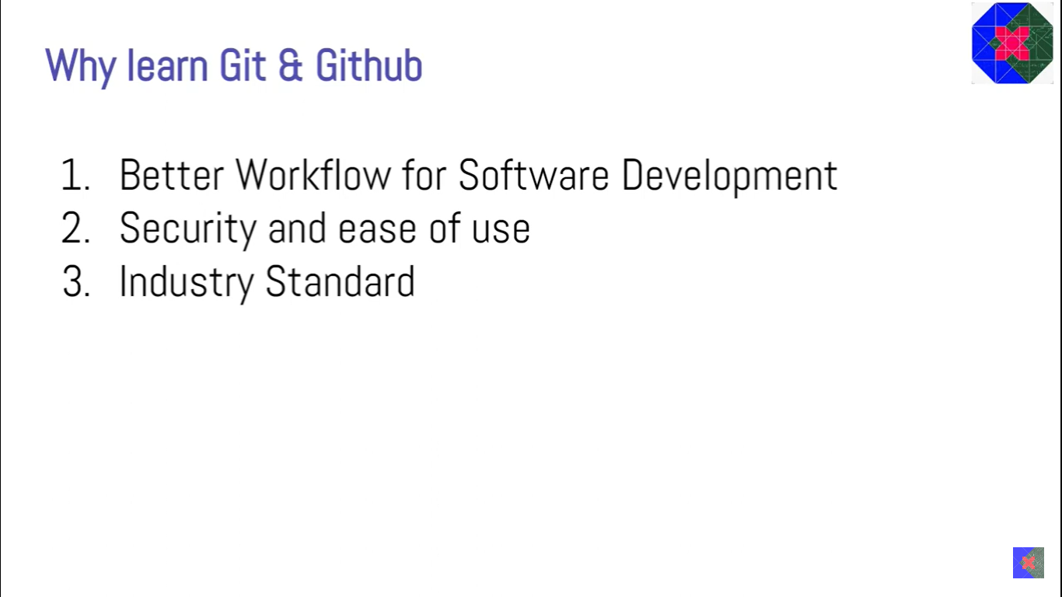

Slide 11
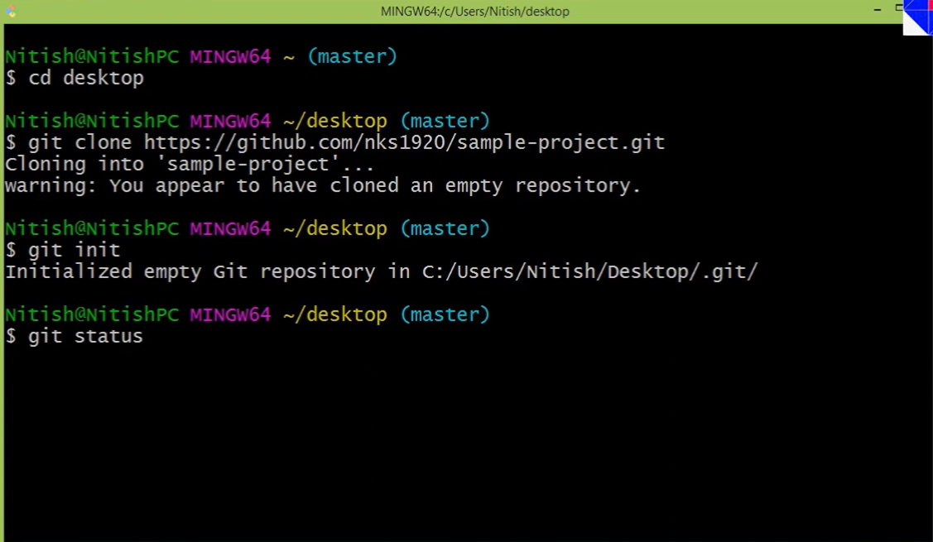

Slide 12
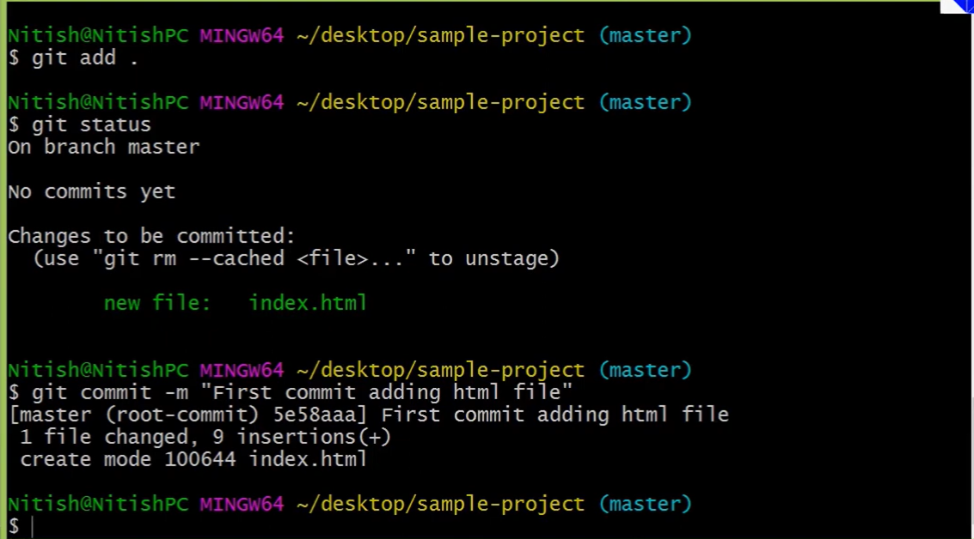

Slide 13
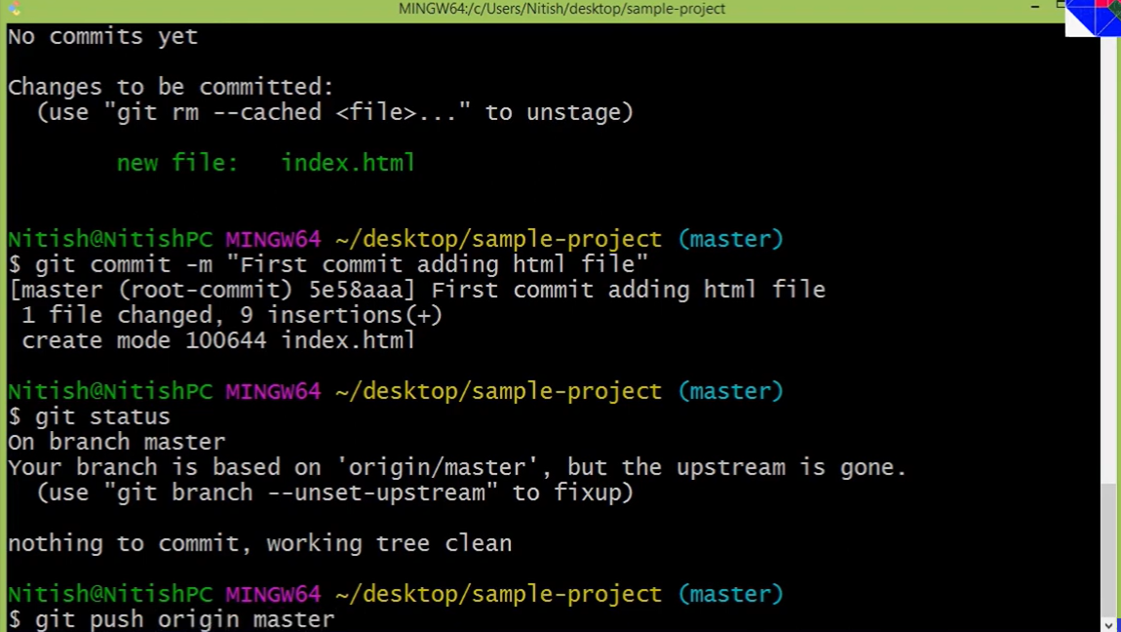

Slide 14
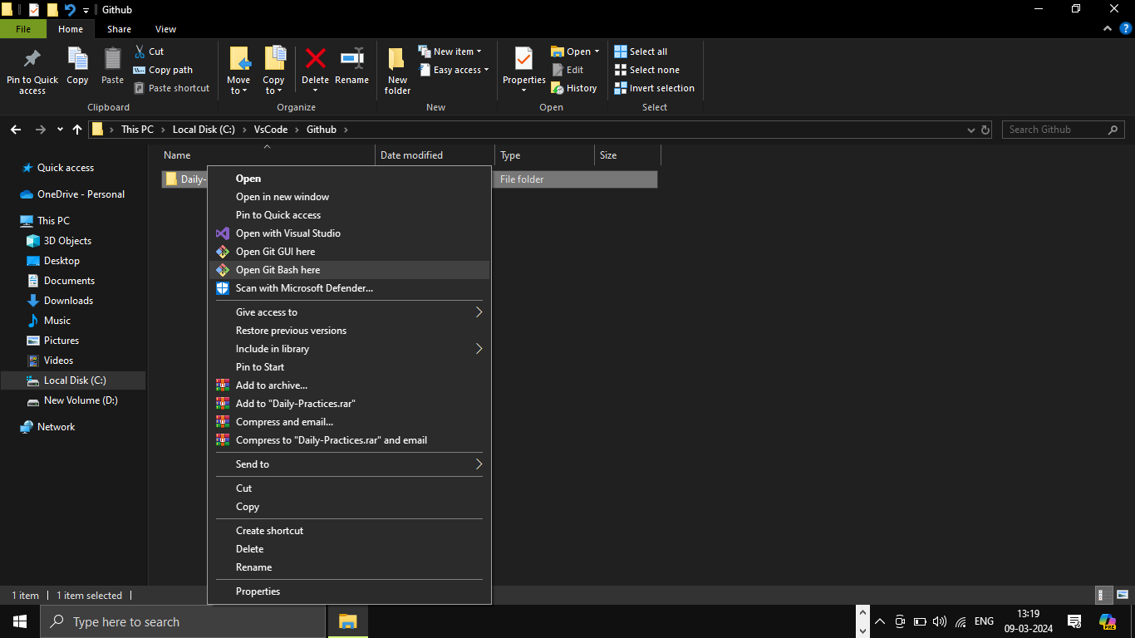
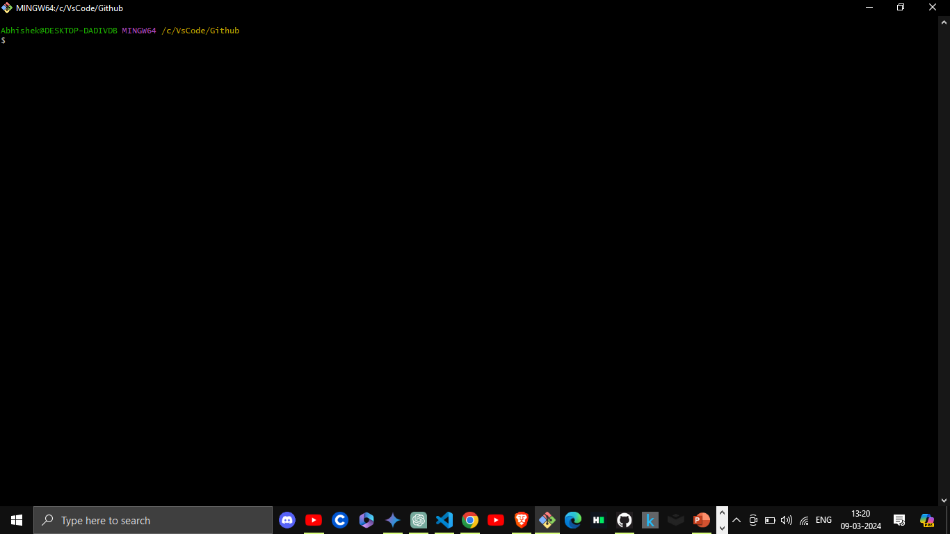

Slide 15
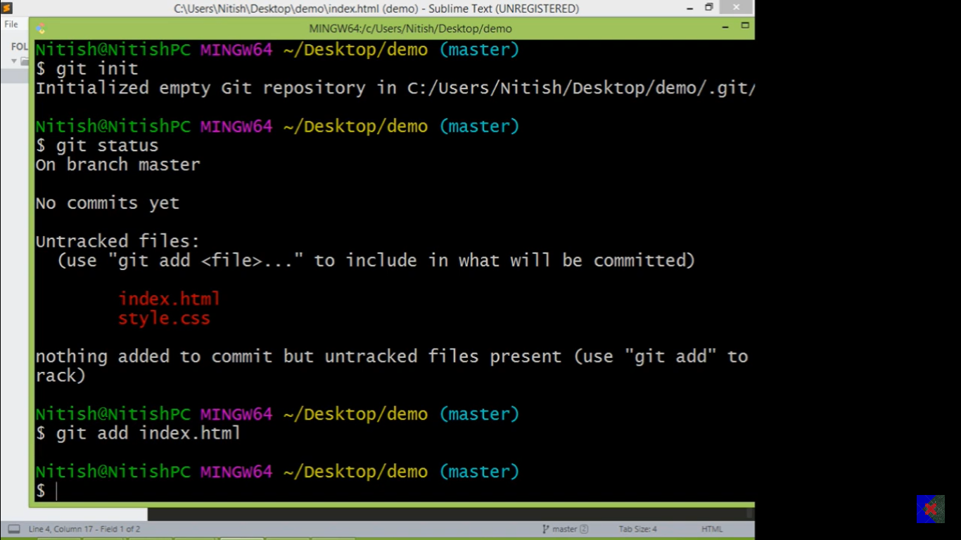

Slide 16
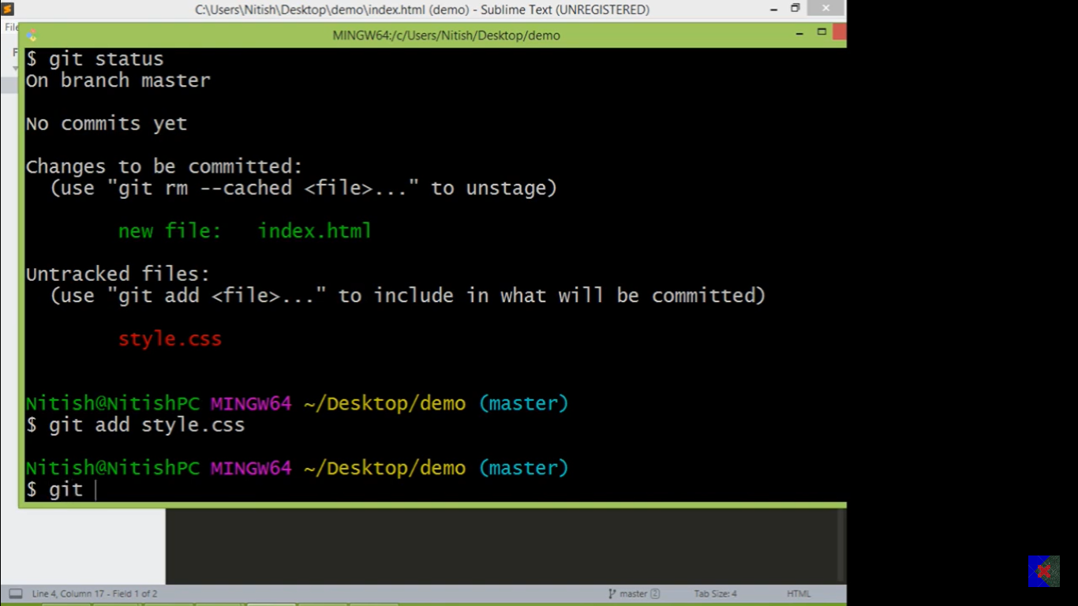

Slide 17
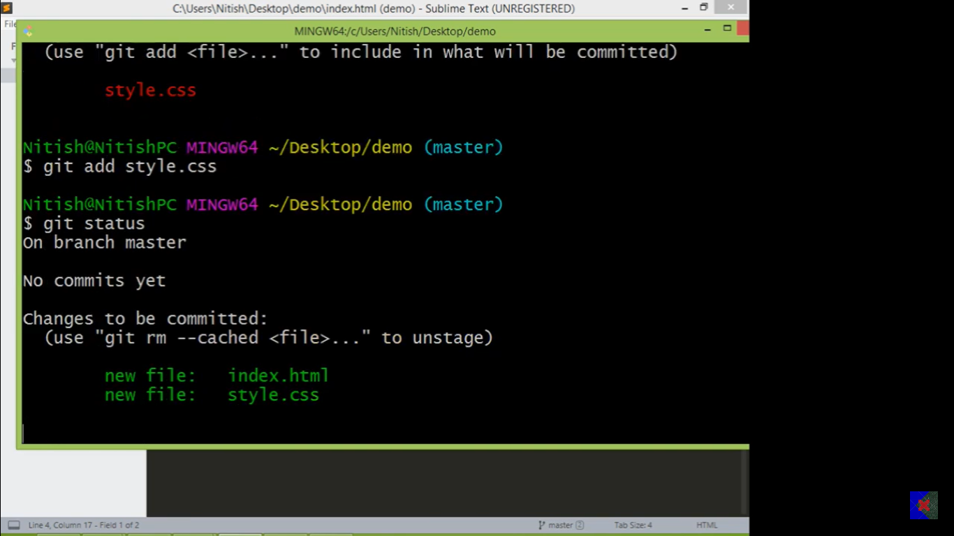

Slide 19
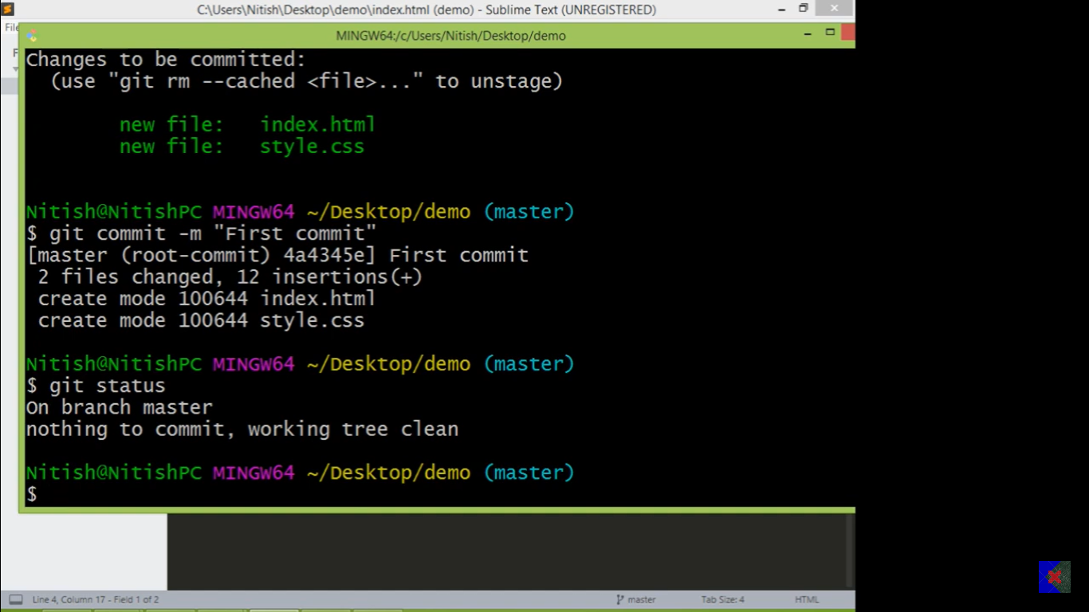
Now if you change any file git can track

Slide 20
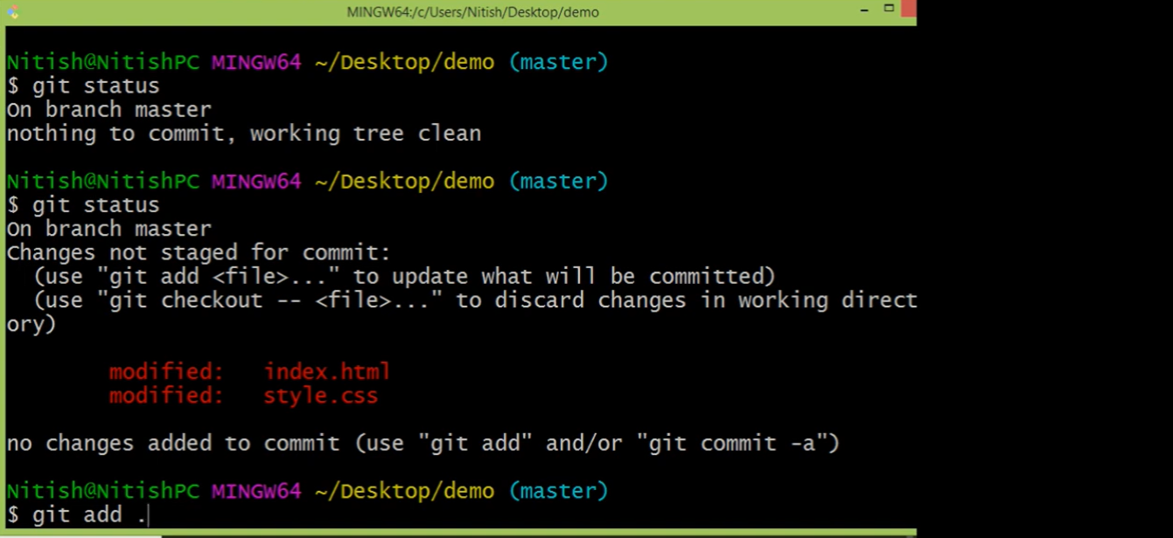
Git add .changes all the file changes at once

Slide 21
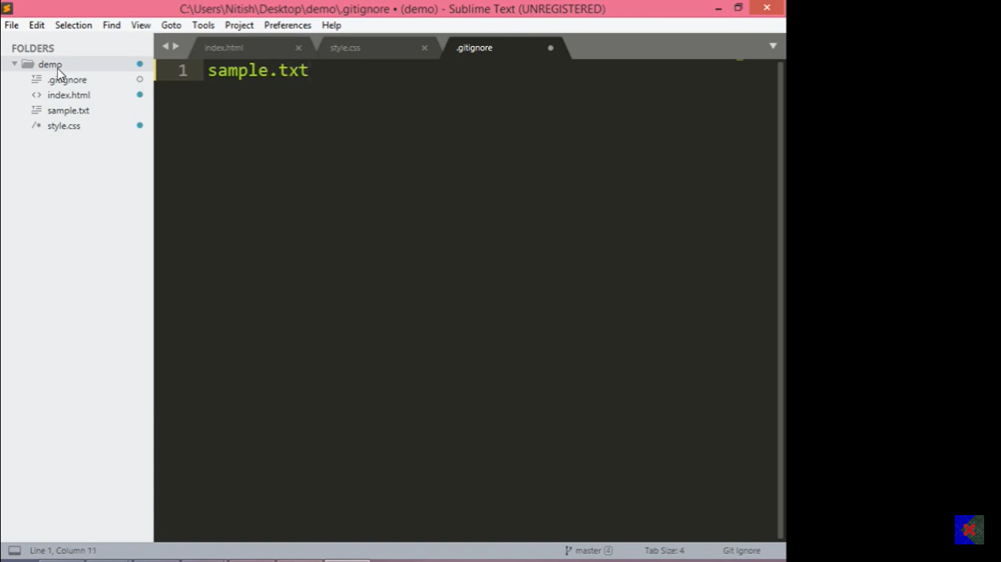
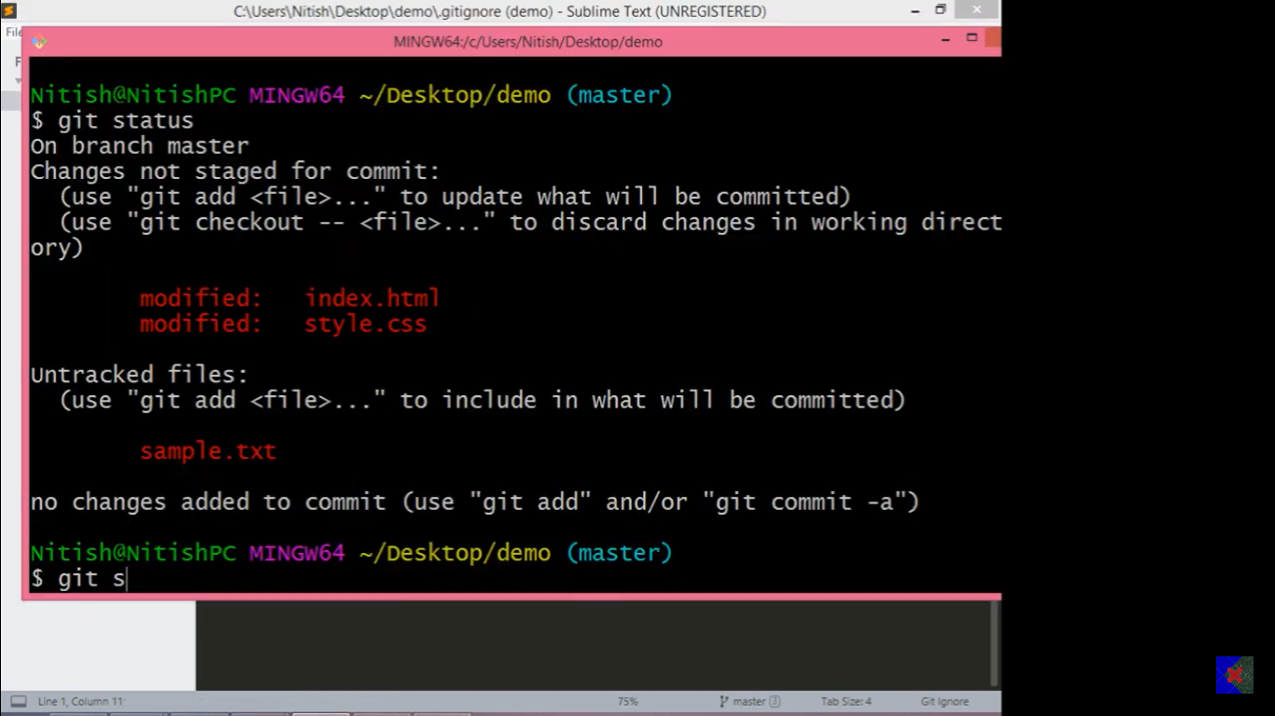
But what if I do not want to change something in all of that.
Simply go to the current code editor file make a folder “.gitignore” and write that file name in this folder.

Slide 22
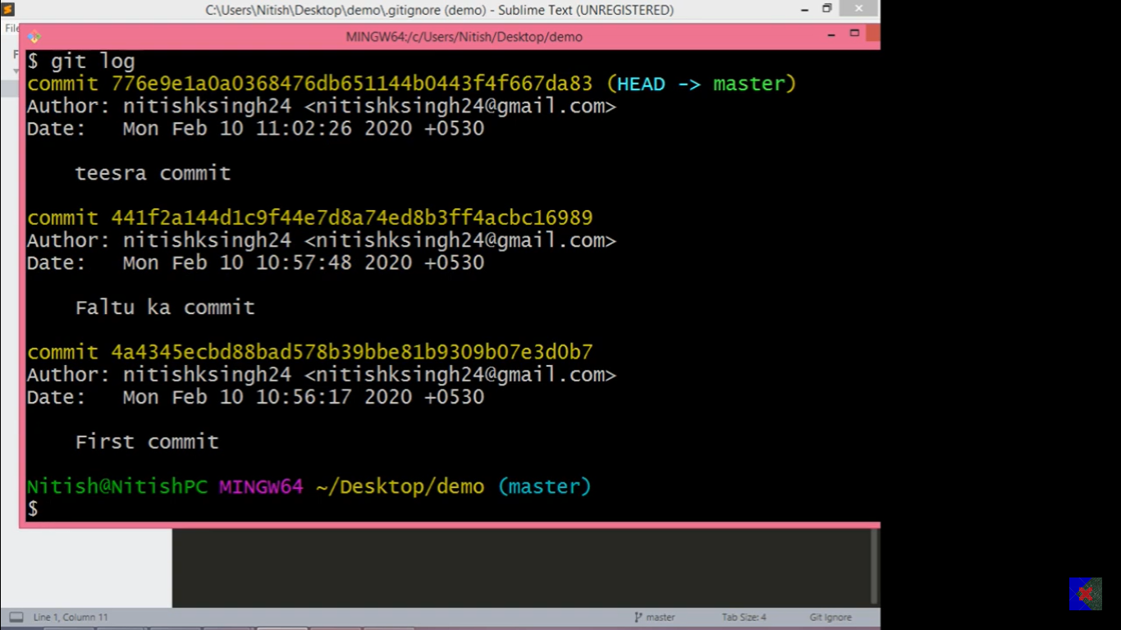
If you want to see all commit version git log

Slide 23
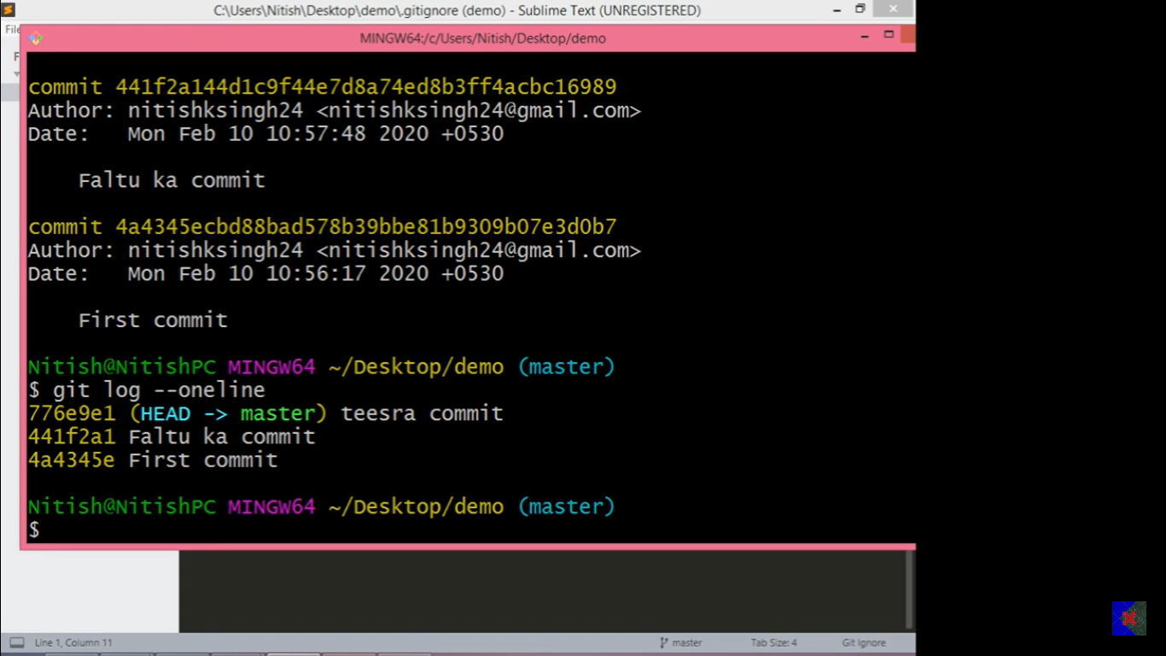
If you do not Want to see all commit version git log --one line

Slide 24
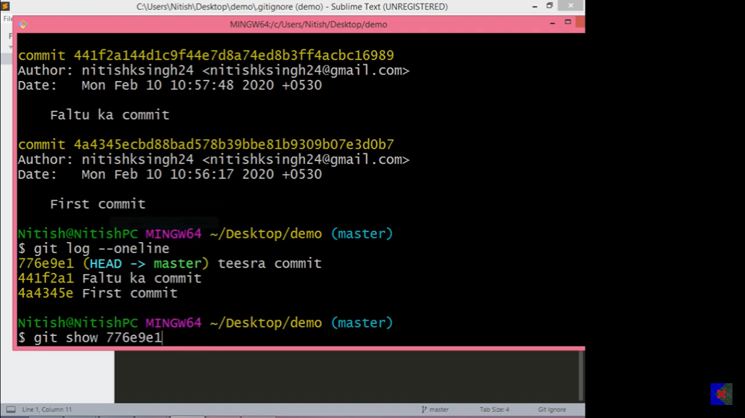
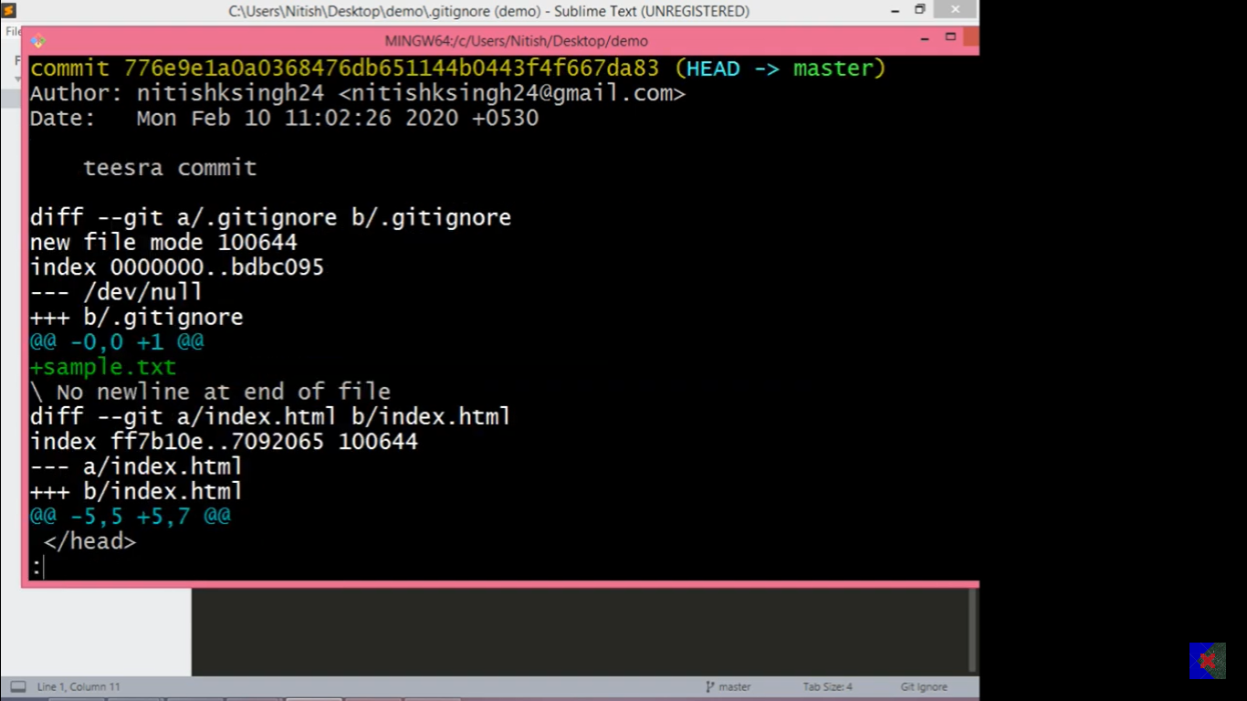
If you Want to see one single commit version from all of this git show

Slide 25
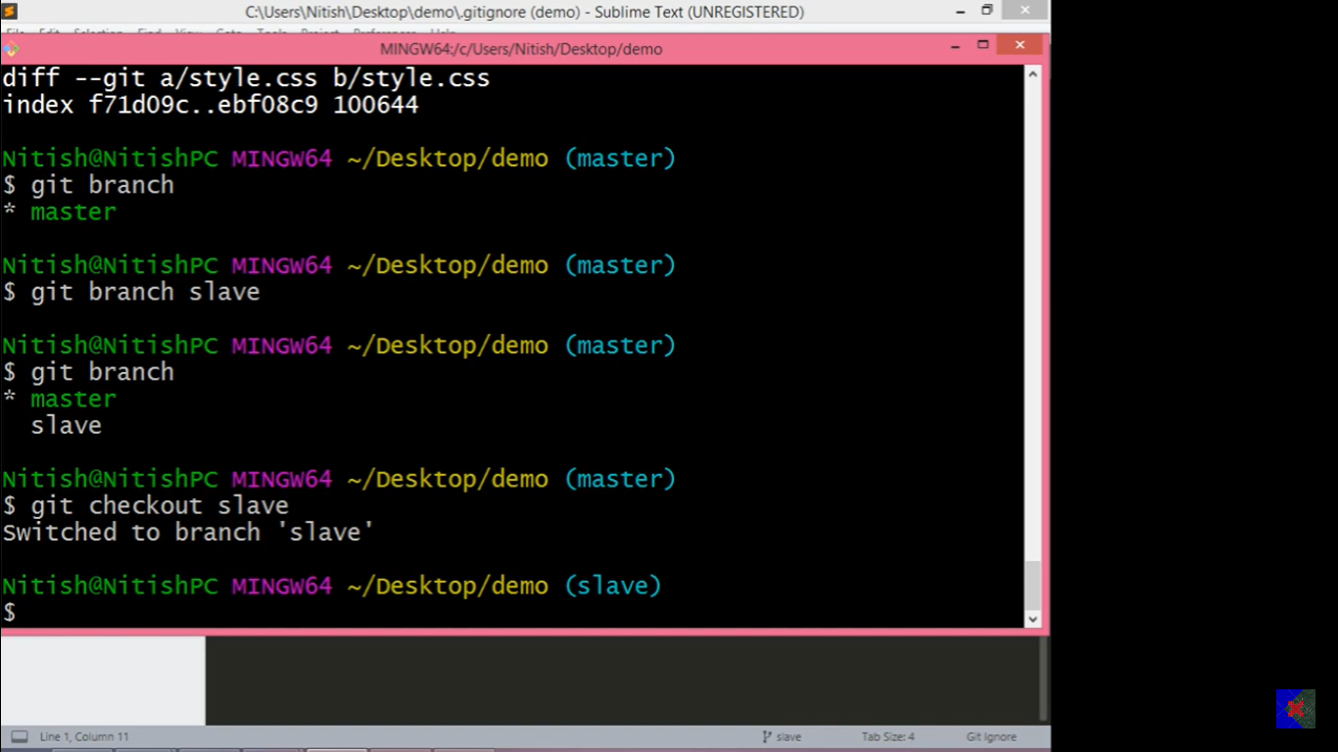
How to check and create new branch

Slide 26
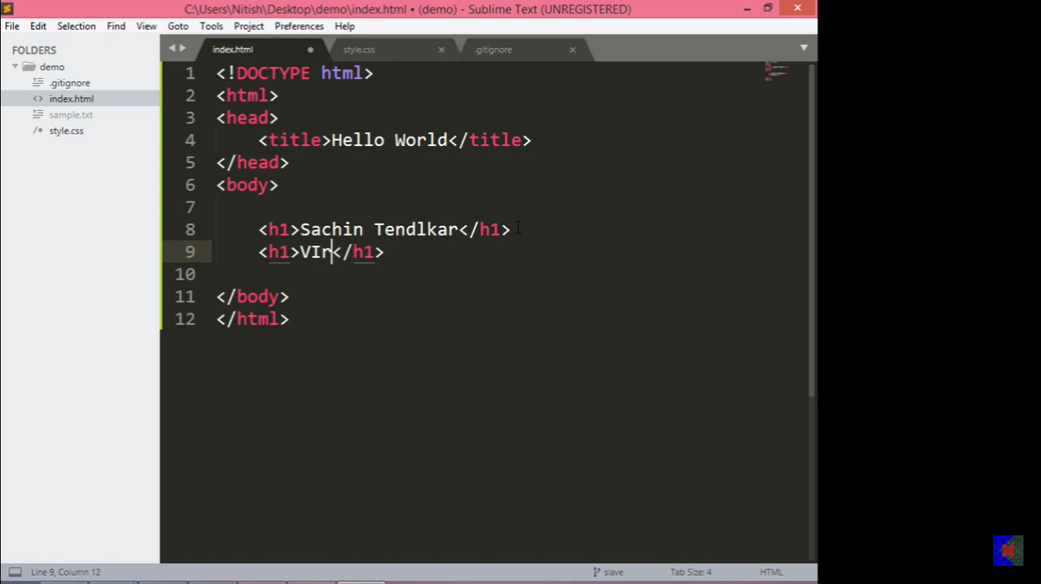
Now this code is part of slave

Slide 27
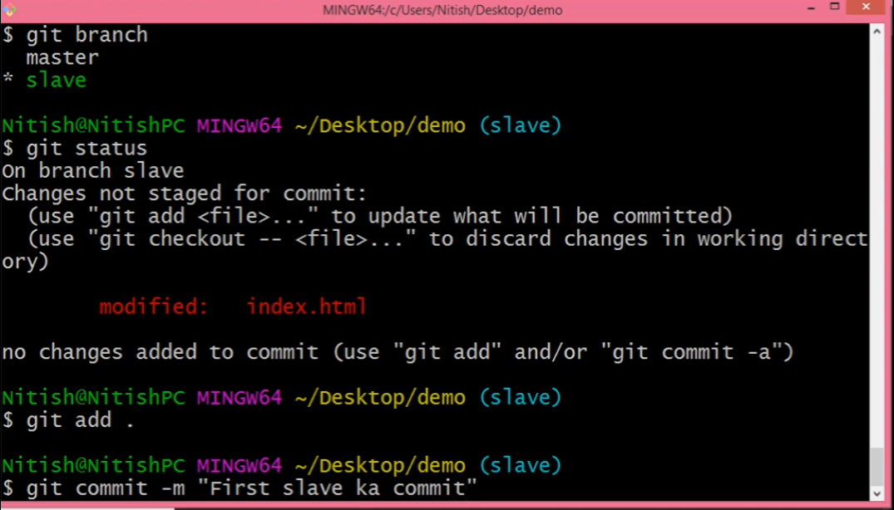

Slide 28
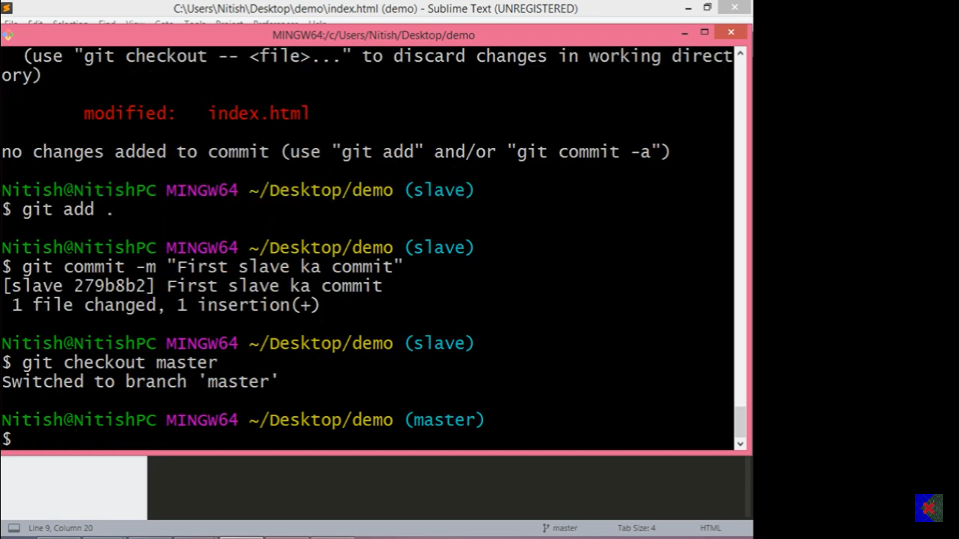
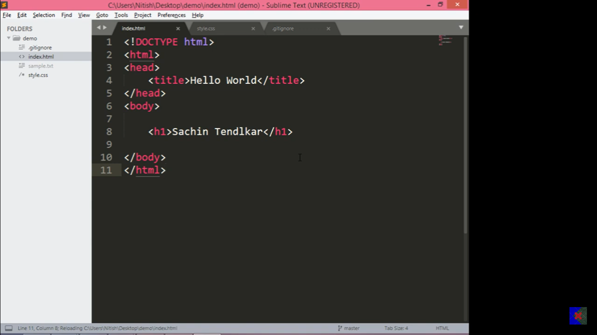
Now if you go in the master branch you can see no change in this branch code file
Only Sachin is showing
Because of changes we have done in the slave branch that are happening within that branch while both working on the same file that’s the best part of that

Slide 29

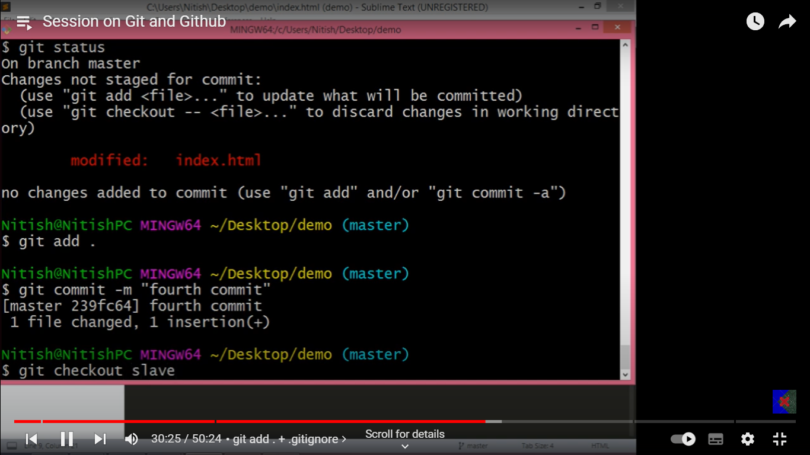
Now we have made changes again in the master branch

Slide 30
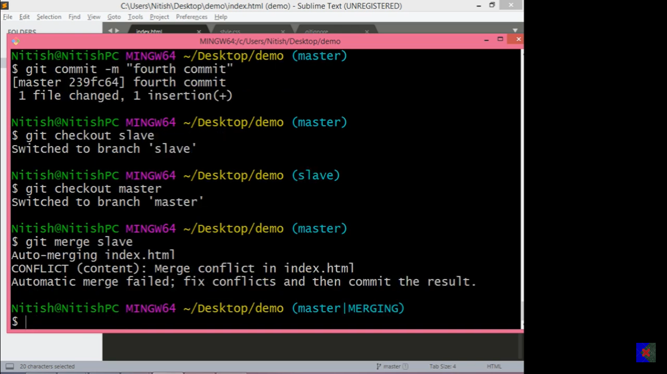
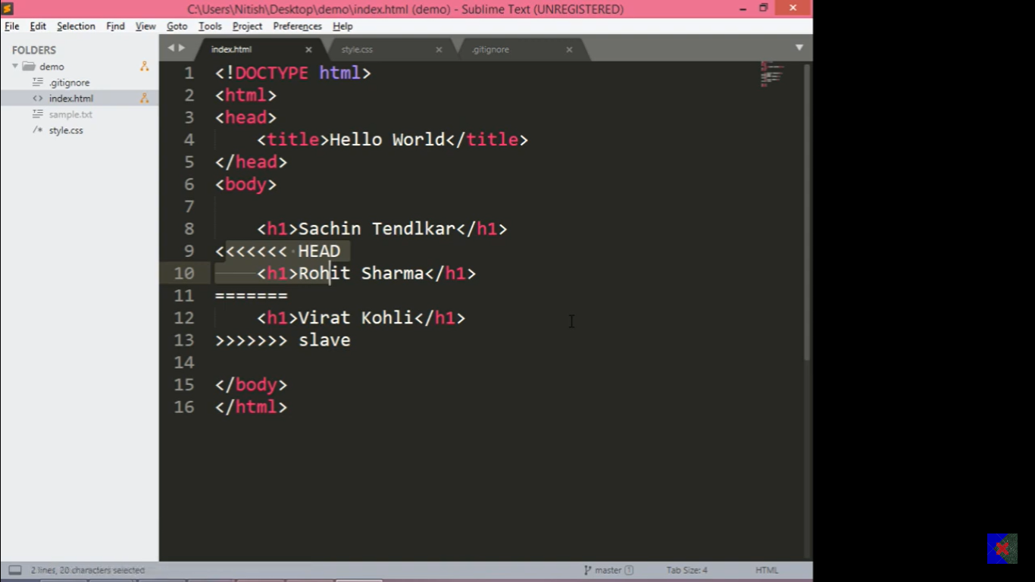
Now we are going to merge and we should merge from the master branch.
Command is “git merge slave(command name which you want ot merge)”

Slide 31
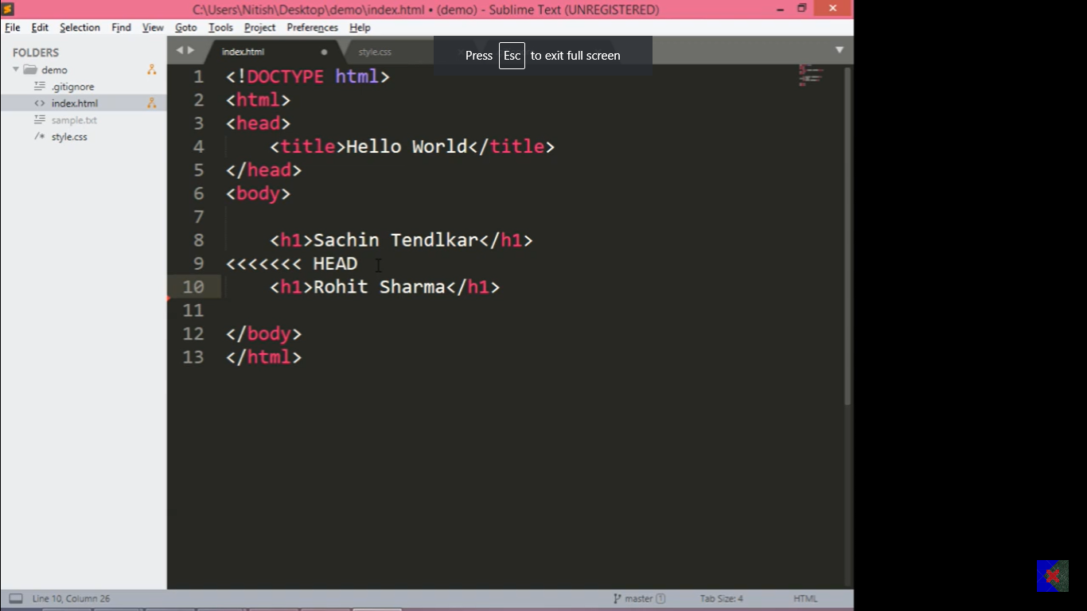
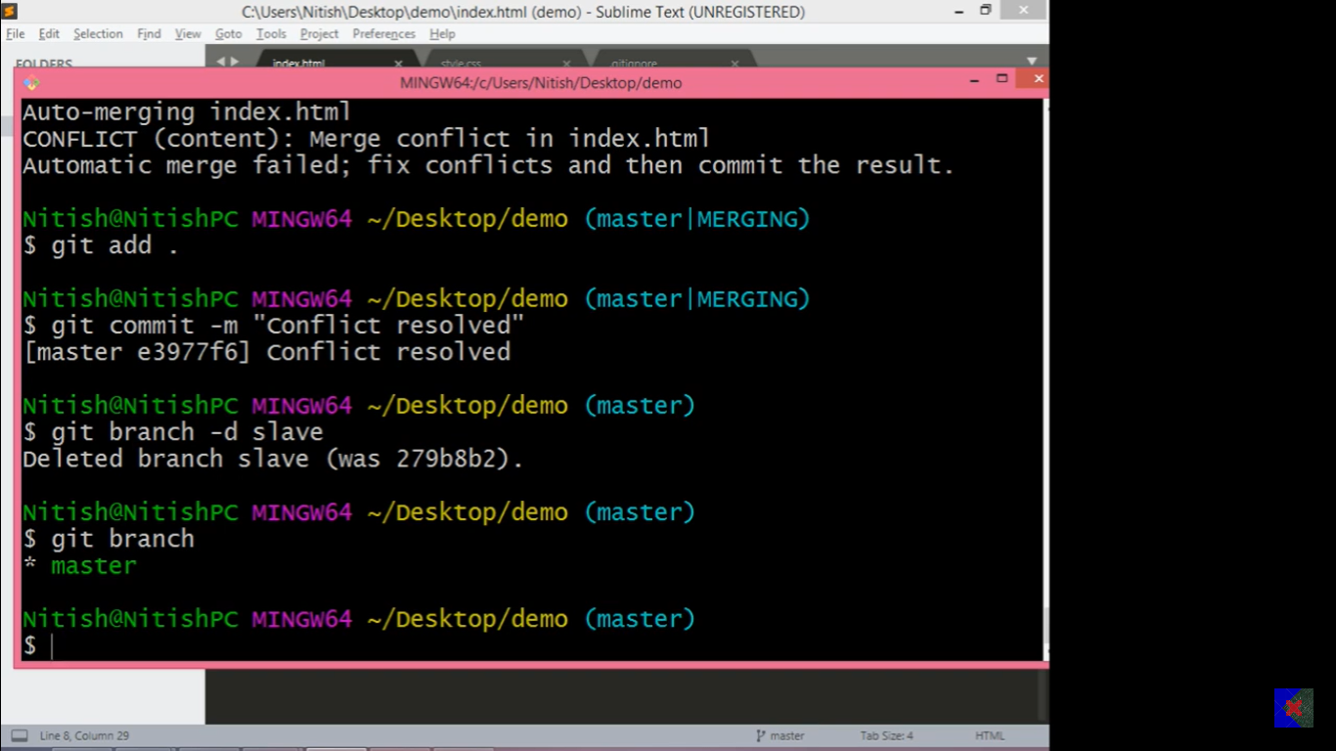
Now we can simply remove the conflict code and saved
after discussed to their respective owner and commit –m ‘commit conflict resolved”

Slide 32

Now we finally branch has done their work so we can now delete that branch

Slide 33
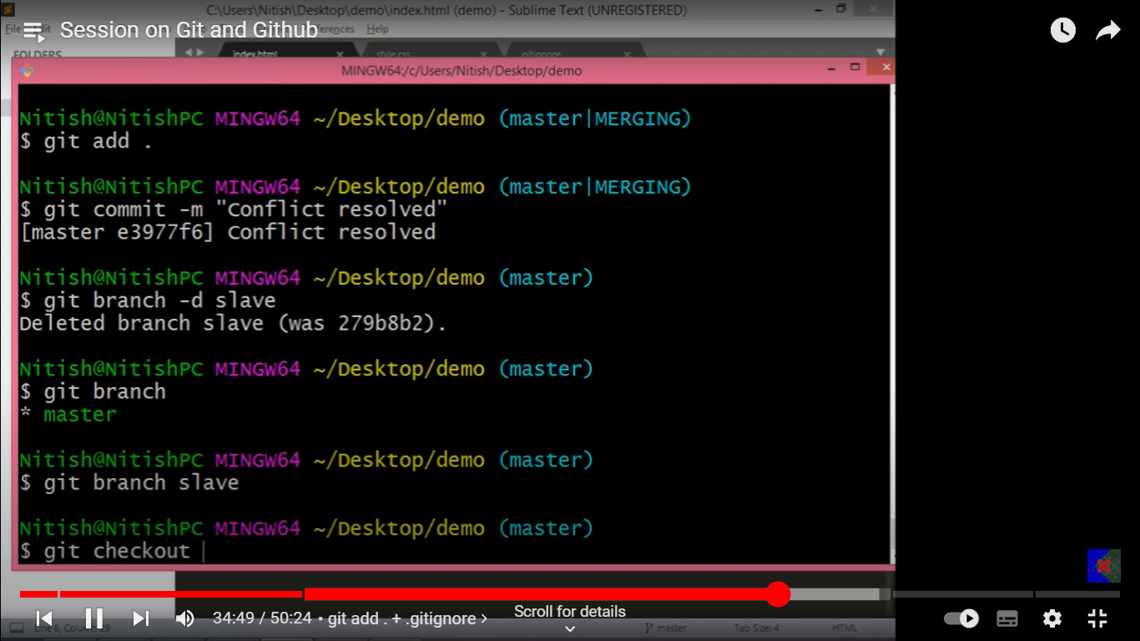
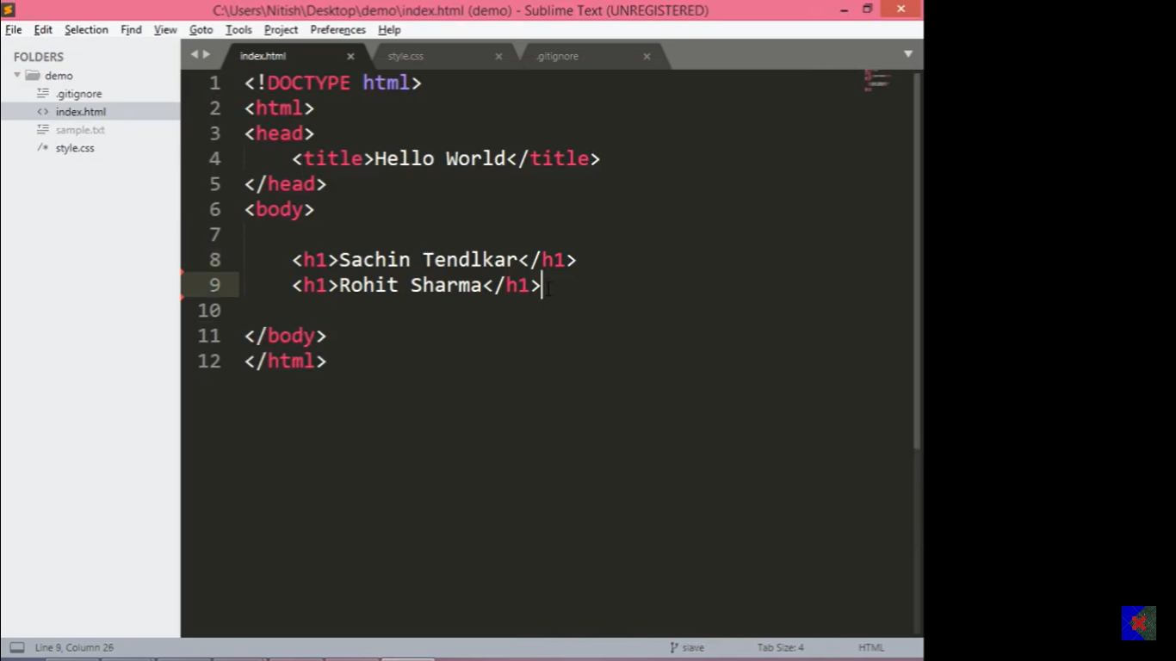
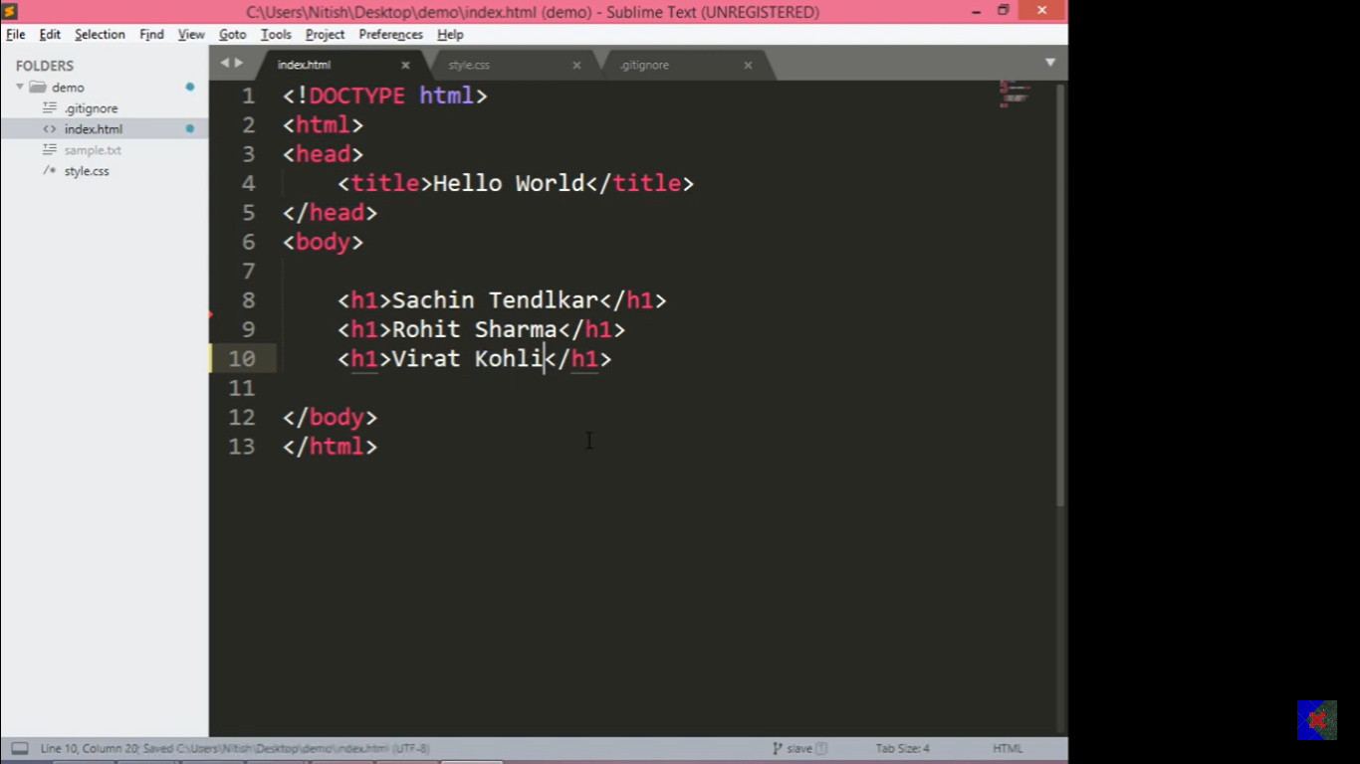
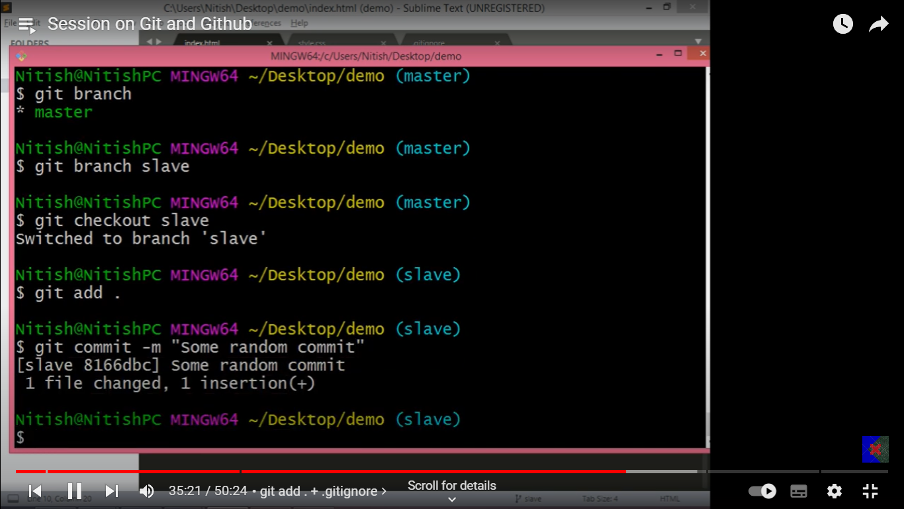
Fast forward merging
Let’s make a new branch slave and make changes in the code it’s all happening in slave branch only.
Now add and commit

Slide 34
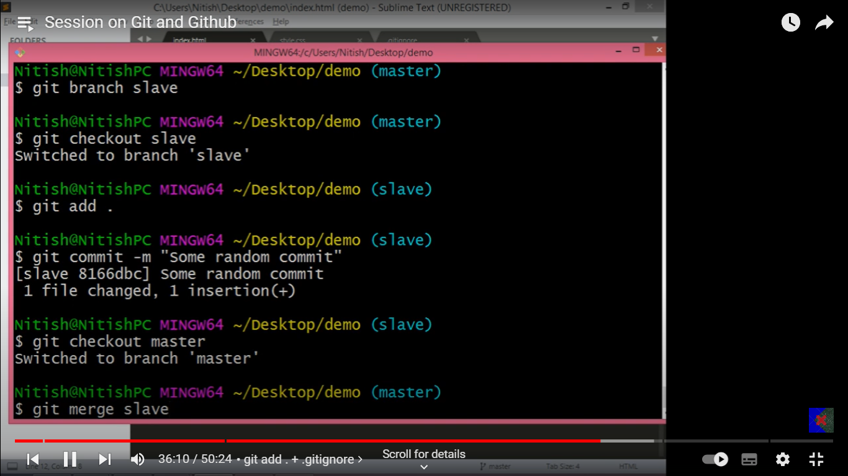

Now If we again go to master branch and can see no changes appers here’s

Slide 35
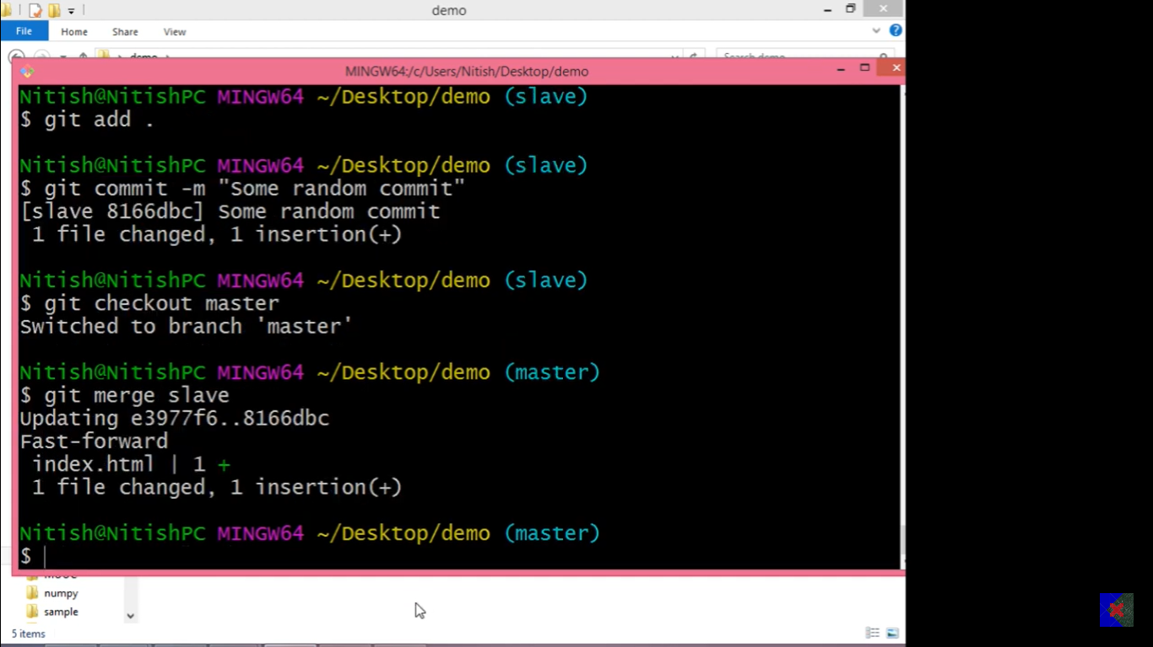

But after merging the slave we can see changes appear in master branch although the master branch has not done anything but slave branch has done even of these work like a friend went on holiday and another has done their work.

Slide 36
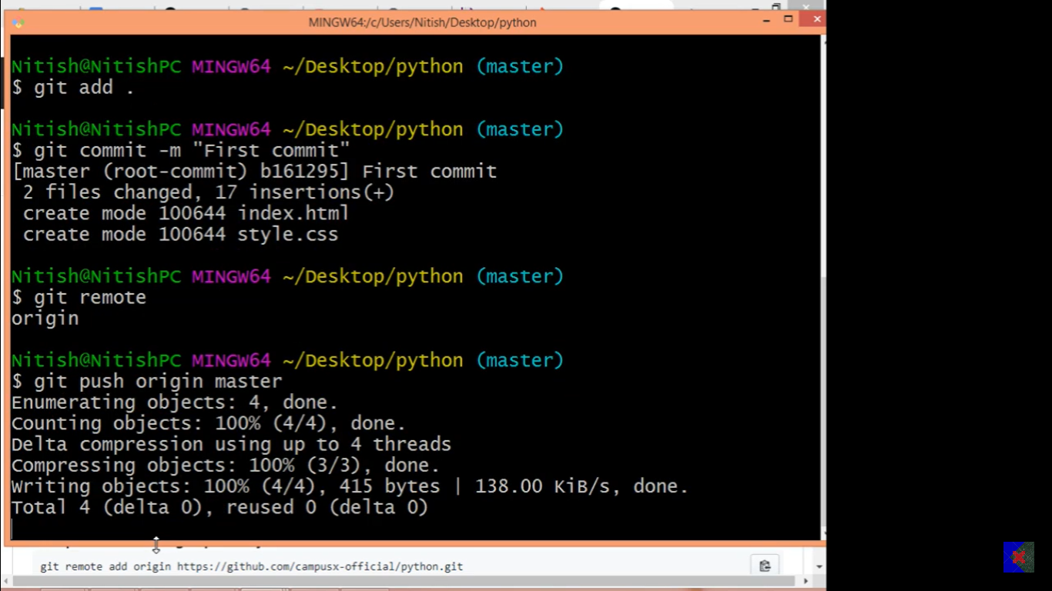

Slide 37
So the best part is to make a repository and Clone it Put the file under this folder.
Git push origin master
END

